Slide 1
Supervised Learning Techniques over Twitter Data
Kleisarchaki Sofia

Slide 2
Supervised Learning Algorithms - Process
Problem
Identification of required data
Data pre-processing
Def. of training set
Algorithm Selection
Parameter Tuning
Training
Evaluation with test set
no
ok?
yes
Classifier

Slide 3
Applying SML on our Problem
Problem
Event Detection
Data from social networks (i.e Twitter)
Identification of required data
Select the most informative attributes, features
Data pre-processing
Def. of training set
i.e. 2/3train, 1/3 estimating
Algorithm Selection
Algorithm Selection???
Parameter Tuning
Training
Parameter Tuning
Training
Evaluation with test set
Evaluation with test set
no
ok?
yes
Classifier
ok?
no
yes
Classifier

Slide 4
Algorithm Selection
Logic Based Algorithms
  Decision Trees, Learning Set of Rules
Perceptron Based Algorithms
  Single/Multiple Layered Perceptron, Radial Basis Function (RBF)
Statistical Learning Algorithms
  Naive Bayes Classifier, Bayesian Networks
Instance Based Learning Algorithms
  k-Nearest Neighbours (k-NN)
Support Vector Machines (SVM)

Slide 5
Earthquake shakes Twitter Users: Real-time Event Detection by Social Sensors
Earthquake Detection
Data Pre-Processing
Twitter API (Q=“earthquake, shaking”)
Separate sentences into a set of words.
Apply stemming and stop-words elimination (morphological analysis).
Extract Features A, B, C.
Training Set: 592 positive examples.
Apply classification using SVM algorithm with a linear kernel.
The model classifies tweets automatically into positive and negative categories.
Obtain feature A
#of words
Position of q-word
Obtain feature B
Words in tweet
Obtain feature C
Words before & after q-word
Definition of Training Set
Apply Classification (SVM Algorithm)
Training
Evaluation
Classifier

Slide 6
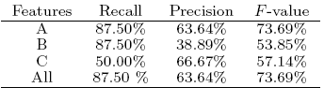
Earthquake shakes Twitter Users: Real-time Event Detection by Social Sensors
Earthquake Detection
Evaluation by Semantic Analysis
Twitter API (Q=“earthquake, shaking”)
Obtain feature A
#of words
Position of q-word
Obtain feature B
Words in tweet
Obtain feature C
Words before & after q-word
Definition of Training Set
Feature B, C do not contribute much to the classification performance.
User becomes surprised and produce a very short tweet.
Low recall is due to the difficulty, even for humans, to decide if a tweet is actually reporting an earthquake.
Apply Classification (SVM Algorithm)
Training
Evaluation
Classifier

Slide 7
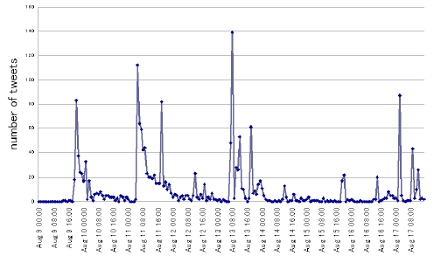

Event Detection & Location Estimation Algorithm
Earthquake Detection
Temporal Model
Twitter API (Q=“earthquake, shaking”)
Each tweet has its post time.
The distribution is an exponential distribution.
PDF: f(t; λ) = λ e^-λt, λ: fixed probability of posting a tweet from t to Δt.
Obtain feature A
#of words
Position of q-word
Obtain feature B
Words in tweet
Obtain feature C
Words before & after q-word
Apply Classification (SVM Algorithm)
Positive class?
Probability of n sensors returning a false alarm.
yes
Calculate Temporal & Spatial Model
Poccur>Pthres
Probability of event occurrence.
λ=0.34, Pf = 0.35
yes
Event Detected
(Query Map & Send Alert)

Slide 8
Earthquake shakes Twitter Users: Real-time Event Detection by Social Sensors
Earthquake Detection
Spatial Model
Twitter API (Q=“earthquake, shaking”)
Each tweet is associated with a location.
Use Kalman and Particle Filters for location estimation.
Obtain feature A
#of words
Position of q-word
Obtain feature B
Words in tweet
Obtain feature C
Words before & after q-word
Apply Classification (SVM Algorithm)
Positive class?
yes
Calculate Temporal & Spatial Model
Poccur>Pthres
yes
Event Detected
(Query Map & Send Alert)

Slide 9
Streaming FSD with application to Twitter
Problem: Solve FSD problem using a system that works in the streaming model and takes constant time to process each new document and also constant space.

Slide 10
Streaming FSD with application to Twitter
Get document d
Locality Sensitivity Hashing (LSH)
Apply method LSH
S← set of points that collide with d in LSH
Solves approximate-NN problem in sublinear time.
Introduced by Indyk & Motwani (1998)
This method relied on hashing each query point into buckets in such a way that the probability of collision was much higher for points that are near by.
When a new point arrived, it would be hashed into a bucket and the points that were in the same bucket were inspected and the nearest one returned.
, #of hash tables
, probability of two points x, y colliding
δ, probability of missing a nearest neighbour
Apply FSD
dismin(d) >= t
Compare d to a fixed # of most recent documents & update distance
Add d to inverted index
yes
Has more docs?

Slide 11
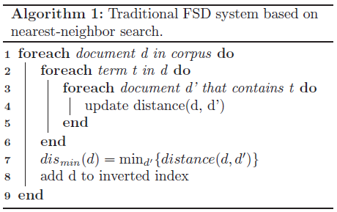
Streaming FSD with application to Twitter
Get document d
First Story Detection (FSD)
Apply method LSH
S← set of points that collide with d in LSH
Each document is compared with the previous ones. If its similarity to the closest document is below a certain threshold, the new document is declared to be first story.
Apply FSD
dismin(d) >= t
Compare d to a fixed # of most recent documents & update distance
Add d to inverted index
yes
Has more docs?

Slide 12
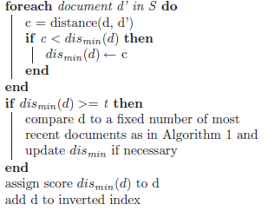
Streaming FSD with application to Twitter
Get document d
Variance Reduction Strategy
Apply method LSH
S← set of points that collide with d in LSH
LSH only returns the true near neighbour.
To overcome the problem, compare the query with a fixed number of most recent documents.
Apply FSD
dismin(d) >= t
Compare d to a fixed # of most recent documents & update distance
Add d to inverted index
yes
Has more docs?

Slide 13
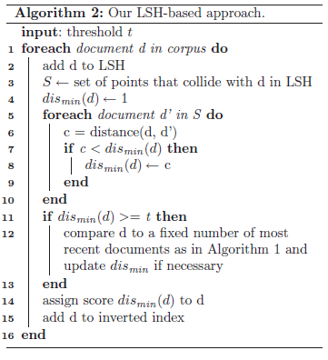
Streaming FSD with application to Twitter
Get document d
Algorithm
Apply method LSH
S← set of points that collide with d in LSH
Apply FSD
dismin(d) >= t
Compare d to a fixed # of most recent documents & update distance
Add d to inverted index
yes
Has more docs?

Slide 14
A Constant Space & Time Approach
Limit the number of documents inside a single bucket to a constant.
  If the bucket is full the oldest document is removed.
Limit the number of comparisons to a constant.
  Compare each new document with at most 3L documents it collided with. Take the 3L documents that collide most frequently.

Slide 15
Detecting Events in Twitter Posts
Threading
  Subsets of tweets with the same topic.
  Run streaming FSD and assign a novelty score to each tweet. Output which other tweet is most similar to.
Link Relation
  a links to tweet b, if b is the nearest neighbour of a and
  1-cos(a, b) < thresh
  If the neighbour of α is within the distance thresh we assign it to an existing thread. Otherwise, create a new thread.

Slide 16
Twitter Experiments
163.5 million time stamped tweets.
Manually labelled the first tweet of each thread as:
  Event
  Neutral
  Spam
Gold Standard: 820 tweets on which both annotators agreed.

Slide 17


Twitter Results
Ways of ranking the threads:
  Baseline – random ordering of tweets
  Size of thread – threads are ranked according to #of tweets
  Number of users - threads are ranked according to unique #of users posting in a thread
  Entropy + users
    , ni: #of times word i appears in the thread,
    , total #of words in the thread

Slide 18
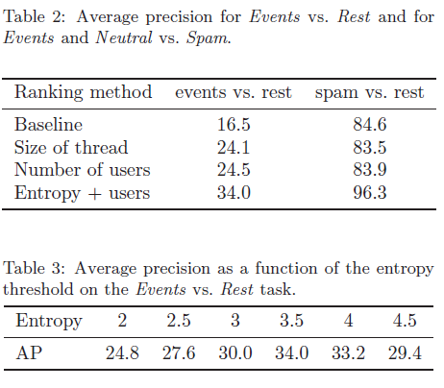
Twitter Results

Slide 19
References
Supervised Machine Learning: A review of Classification Techniques, S.B Kotsiantis
Earthquake shakes Twitter Users: Real-time Event Detection by Social Sensors, Takeshi Sakaki, Makoto Okazaki, Yutaka Matsuo
Streaming First Story Detection with application to Twitter, Sasa Petrovic, Miles Osborne, Victor Lavrenko

